Slide 1

Crafting a Powerful Letter of Motivation
The essential components of a compelling Letter of Motivation and understand how to craft a successful application.
By Uswa Asad , Naveed Ahmad , Sidrah Ishtiaq

Slide 2

What is a Letter of Motivation?
Purpose
Key Elements
A one-page letter showcasing your qualifications and passion.
Introduction, Body, Conclusion

Slide 3

Where is it Required?
1
Admissions to educational programs.
2
Job or internship applications.
3
Volunteer opportunities.

Slide 4
Why Does it Matter?
Demonstrates Interest
Showcases genuine passion for the opportunity.
Boosts Your Application
Adds a personal touch, setting you apart from others.

Slide 5

Structure of the Letter
Opening
1
Introduce yourself and the opportunity.
2
Body
Highlight your skills and experiences.
Conclusion
3
Summarize your qualifications and express enthusiasm.

Slide 6




Opening Paragraph
What are you applying for?
Who are you and what do you do?
Briefly highlight your qualifications.

Slide 7




Body Paragraphs
Share stories behind your achievements.
Demonstrate your understanding of the employer.
Explain your unique value proposition.

Slide 8

Conclusion Paragraph
Reiterate key qualifications.
Express enthusiasm for the opportunity.
Thank the reader.
Include contact information.

Slide 9
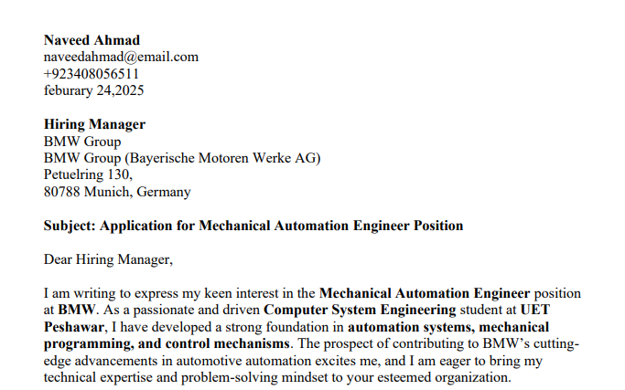
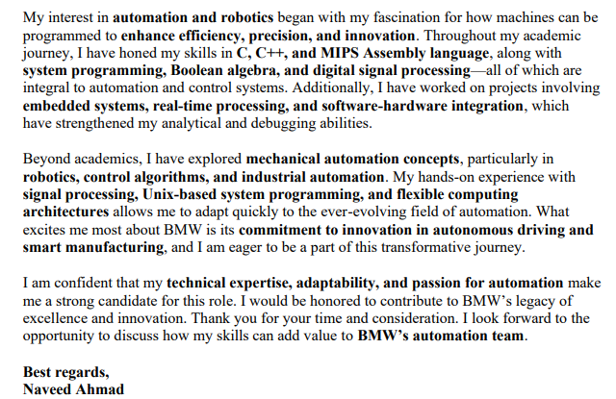

Slide 10
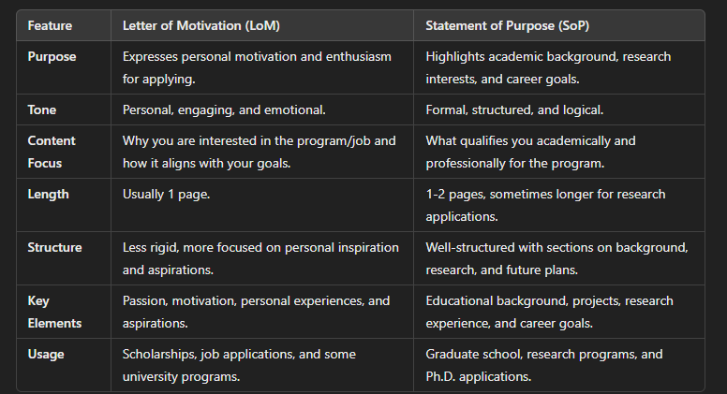
DIFFERNCE BETWEEN LoM and SoP

